Slide 1
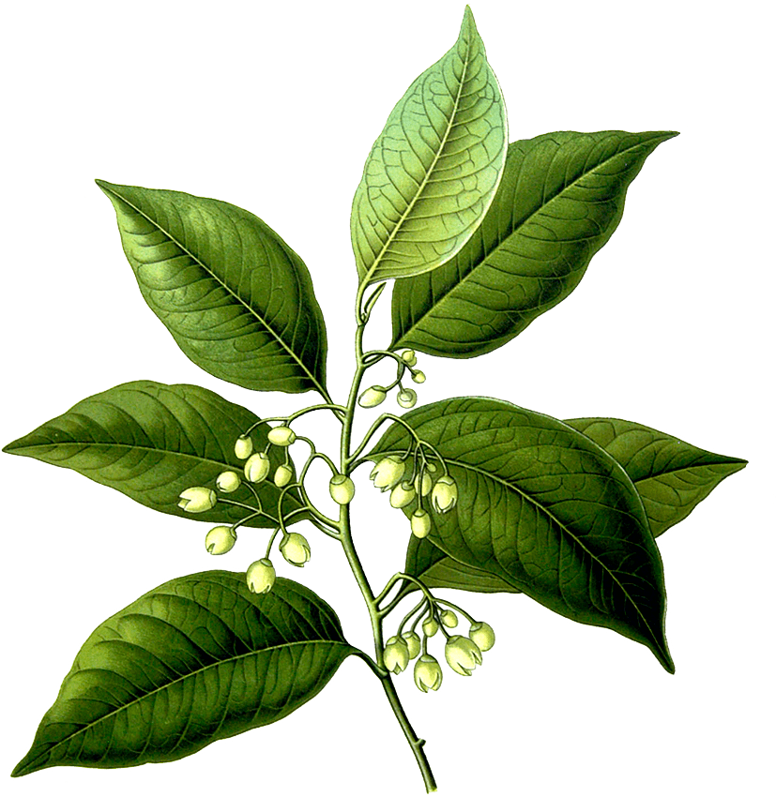


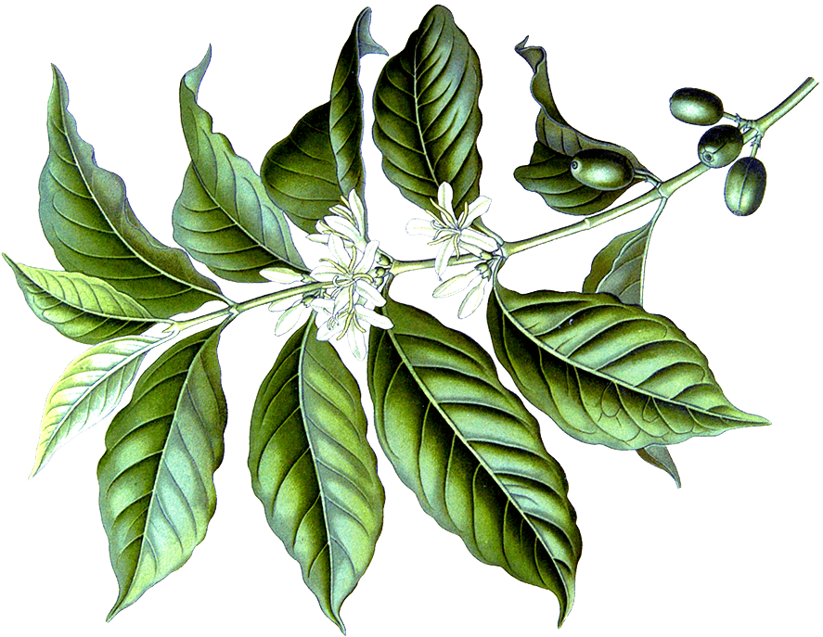

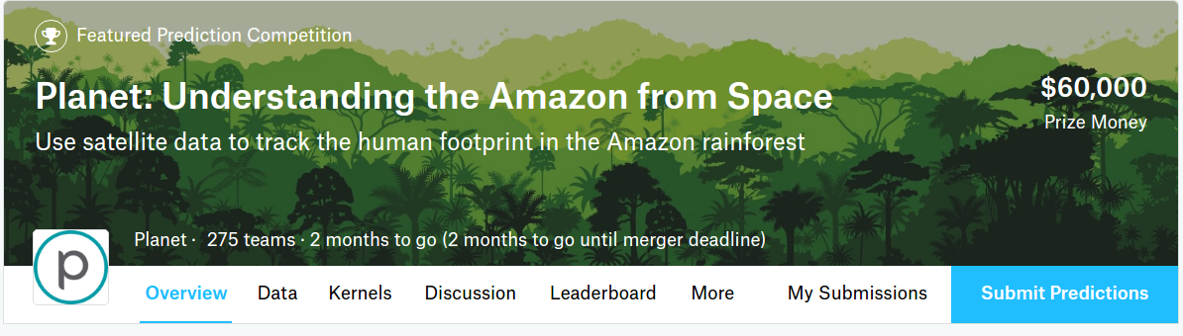
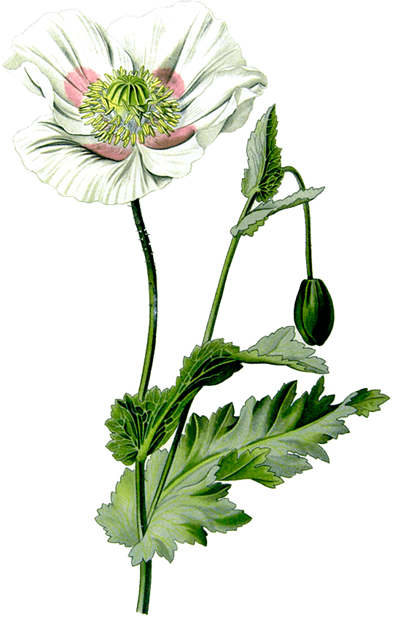




https://www.kaggle.com/c/planet-understanding-the-amazon-from-space
Kaggle starter kit

Slide 2
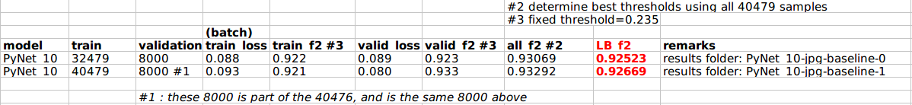
1. How to reproduce the results?
1.1 Expected results
✶ A possible training method is: 1. Split 40479 train datatset into 32479 training samples and 8000 validation samples. Use the above data split to train a network and the learning parameters (e.g. learning rate, max number of epoch). 2. Use all 40479 as training samples to re-train a final network with the same learning parameters 3. Submit results using the final network

Slide 3
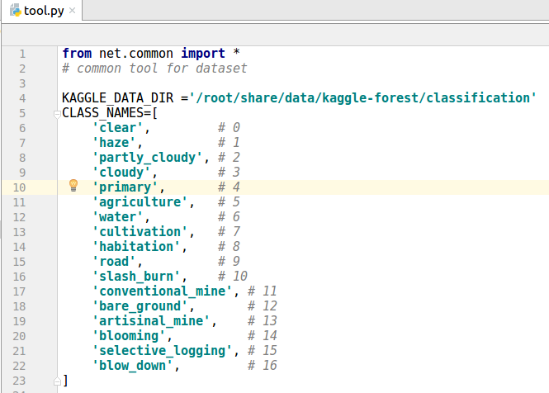
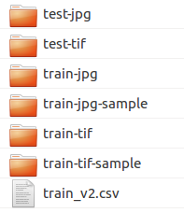
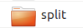
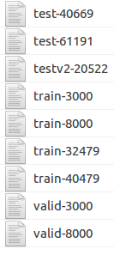
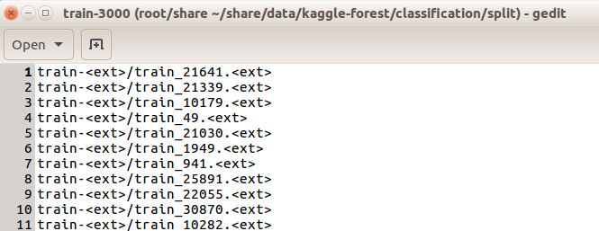
1.2 Data Setup
the data folder
test_xxx and file_xxx images
train_xxx images
format of txt split file

Slide 4
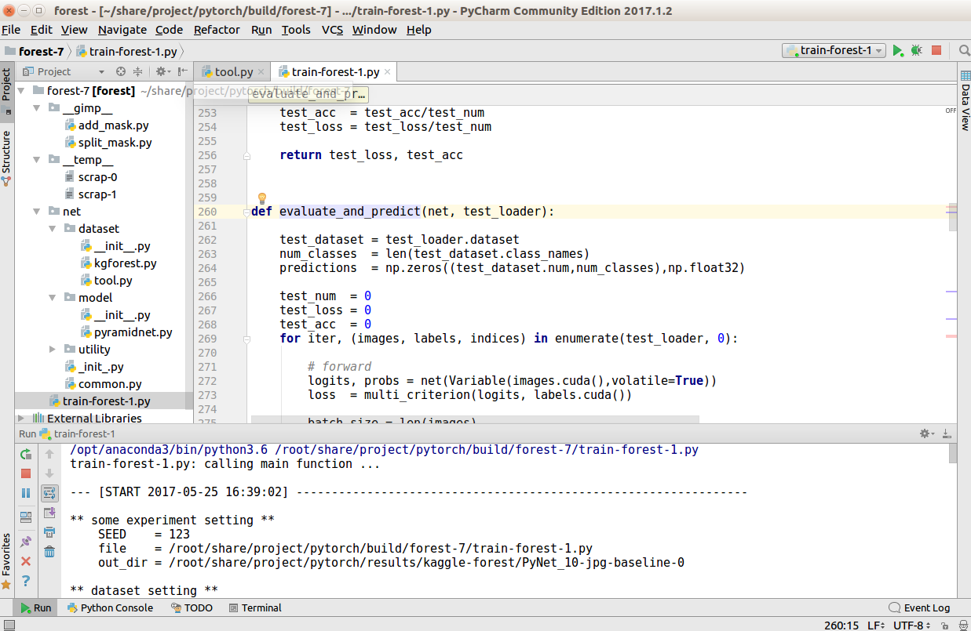
1.3 Software Setup
✶ pyCharm 2017 community edition as python IDE
✶ python 3.6
dataset loader and iterator
network definition
training, evaluation and submission

Slide 5
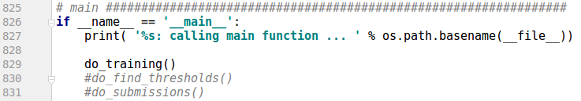
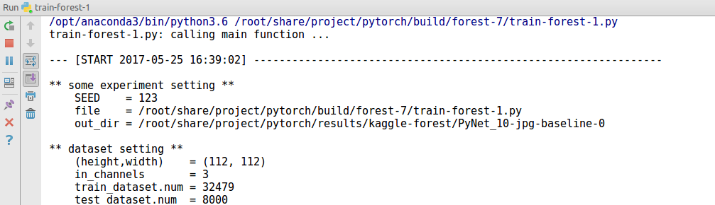
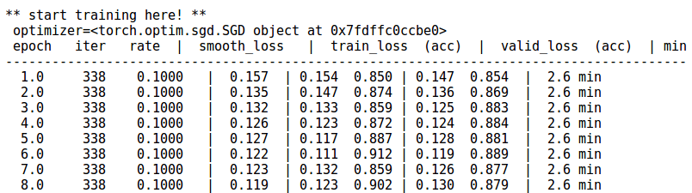
1.4 Making the first results
✶ Run do_training() in main function
train log is created.
logging is saved and shown on screen

Slide 6
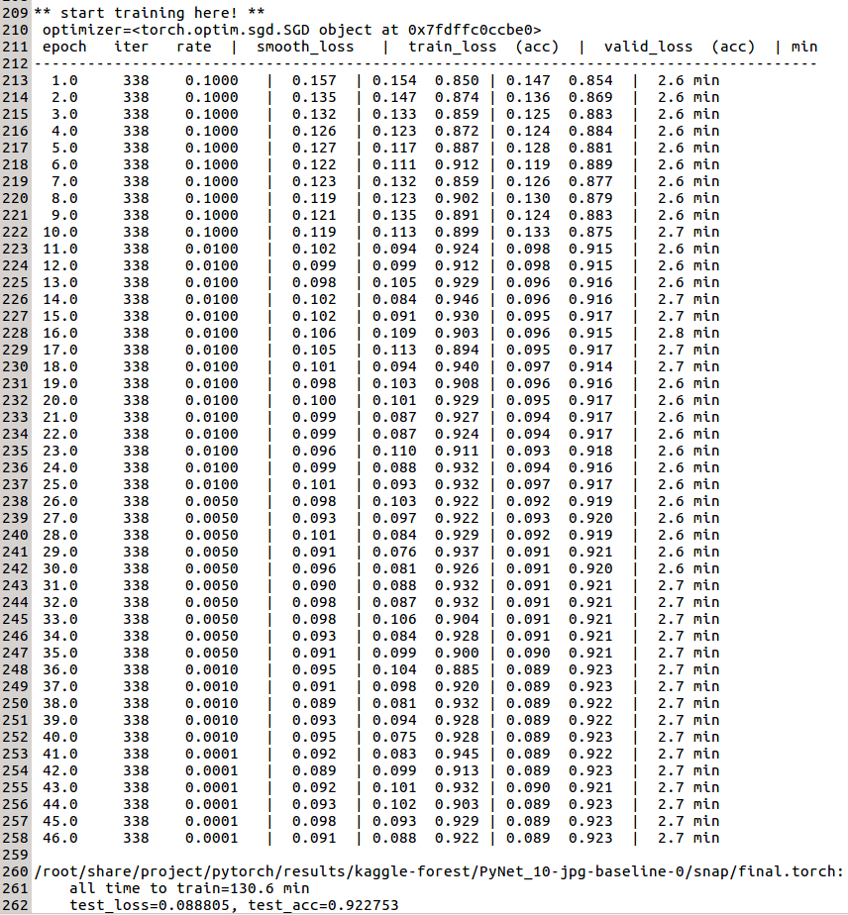
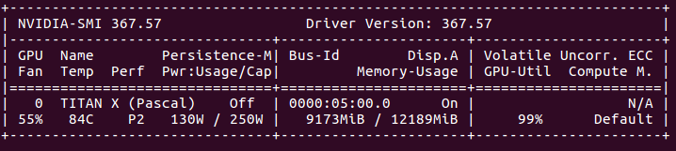
memory requirement
example of training results

Slide 7
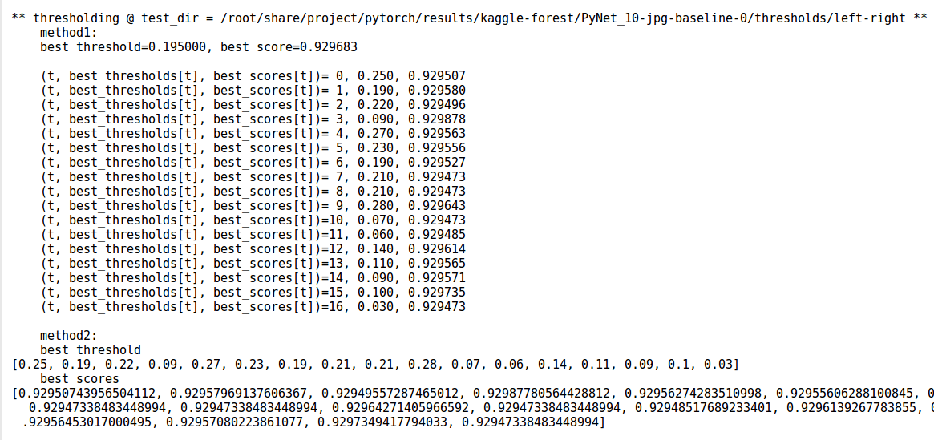
✶ Next, run do_find_thresholds() in main function
example results
copy these threshold for the next step

Slide 8
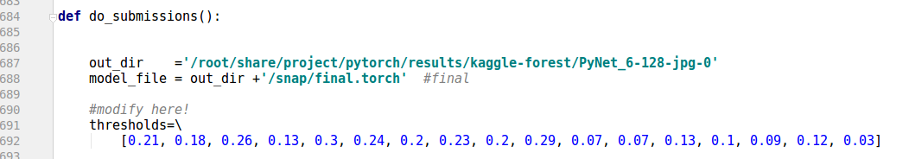
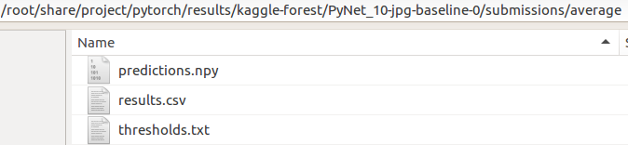
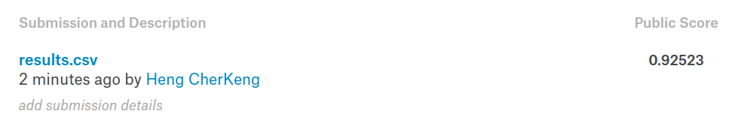
✶ Finally, run do_submissions() in main function
thresholds from previous step
example results
submit this!

Slide 9
2. Collaborative Competitions
close code (unshare)
open code (share to all kagglers)
⚫data annotation
⚫share experiment results ( data split, learning rate, batch size)
⚫results analysis (e.g. plot precision-recall curve)
use share results or code to improve individual system
⚫data augmentation tools
⚫common layer (e.g. batch renormalisation)
✶ Each of us has limited resources (time and gpu).
✶ Some of the results can be shared and why repeated the same exepriments when others have done it before?
✶ If experiments can be coordinated, it would speedup everyone's develeopment

Slide 10
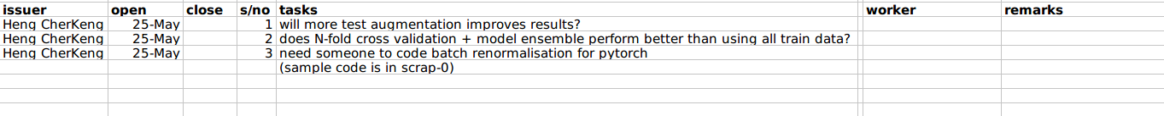
✶ How it works?
- join the slack team and discuss. - put your task in the excel sheet in the share google drive
- anyone who is interested in completeing the task, please fill up here!
- once we have the results, we will share and discuss

Slide 11
3. Explanation of Methods
The network is hown below
feature extraction
classifiers
112x112
preprocess
conv1d
global_max
linear
conv
conv2d
global_max
linear
max/2
conv3d
global_max
linear
conv4
global_max
linear
concatenate
56x56
conv3u
global_max
linear
conv1d
conv1u
conv2u
global_max
linear
+
+
conv1u
global_max
linear
max/2
up/2
drop
sum
28x28
conv2d
conv2u
17x1 (logits)
+
+
max/2
up/2
14x14
conv3d
conv3u
+
+
max/2
up/2
7x7
conv4
+
<details to bre updated ...>

